Slide 1
Introduction to Python
Subject : Programming with Python (IT3008)
Faculty: Mr. Aakash Parmar
Ms. Twinkle Kosambia
Assistant Professor, Computer Science Department,
Asha M. Tarsadia Institute of Computer Science
Website: utu.ac.in
Syllabus of Programming with Python : https://app.utu.ac.in/utuformaccess/utusyllabus.aspx?CF=7&CM=177&SY=1

Slide 2
Programming with Python
Subject code : IT3008
Credits : 5
Theory marks : 60+ 40= 100
Practical marks : 100 (CIE)

Slide 3
Reference books
Text book:
1. Allex Martelli, Anna Ravenscroft and Steve Holden, “Python in Nutshell”, 3rd Edition, O’Reilly Publication.
Reference books:
1. Magnus Lie Hetland, "Beginning Python From Novice to Professional", Third Edition, Apress, 2017.
2. David Beazley, Brian K. Jones, "Python Cookbook", 3rd edition, O’Reilly Publication, 2016.
3. Brett Slatkin, "Effective Python: 59 Specific Ways to Write Better Python", Novatec, 2016.
4. Mark Lutz "Learning Python", 4th Edition, O’Reilly Publication, 2016.

Slide 4
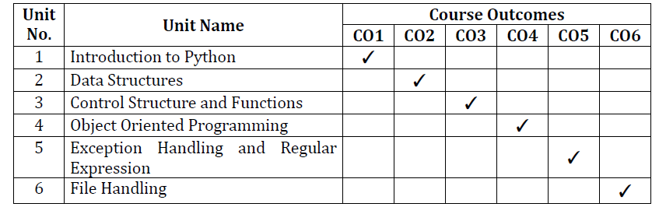
Course outcomes

Slide 5
Unit – I Introduction to Python
Using the Python interpreter, Variables, Identifiers and Keywords, Numbers and Expressions.

Slide 6
Python : A Complete Programming Solution
It is open source and completely free
It runs natively on Windows, Mac OS, linux, and others, as does its standard library and the third party libraries
Third, it fits quick scripting and large development projects equally well

Slide 7
What is Python??
Python is a general purpose language.
high-level,
interpreted,
interactive
object-oriented scripting language
Beginner’s language

Slide 8

Python’s Benevolent Dictator For Life
“Python is an experiment in how much freedom program-mers need. Too much freedom and nobody can read another's code; too little and expressive-ness is endangered.”
- Guido van Rossum

Slide 9
Brief History of Python
Invented in the Netherlands, early 90s by Guido van Rossum
Python was conceived in late 1980s and its implementation was started in December 1989.
Guido Van Rossum was fan of ‘Monty Python’s flying circus’ a famous TV show in Netherland.
Named after Monty Python
Based on ABC(All Basic Code) and Modula3.
Open sourced from the beginning.
Used by Google from the beginning

Slide 10
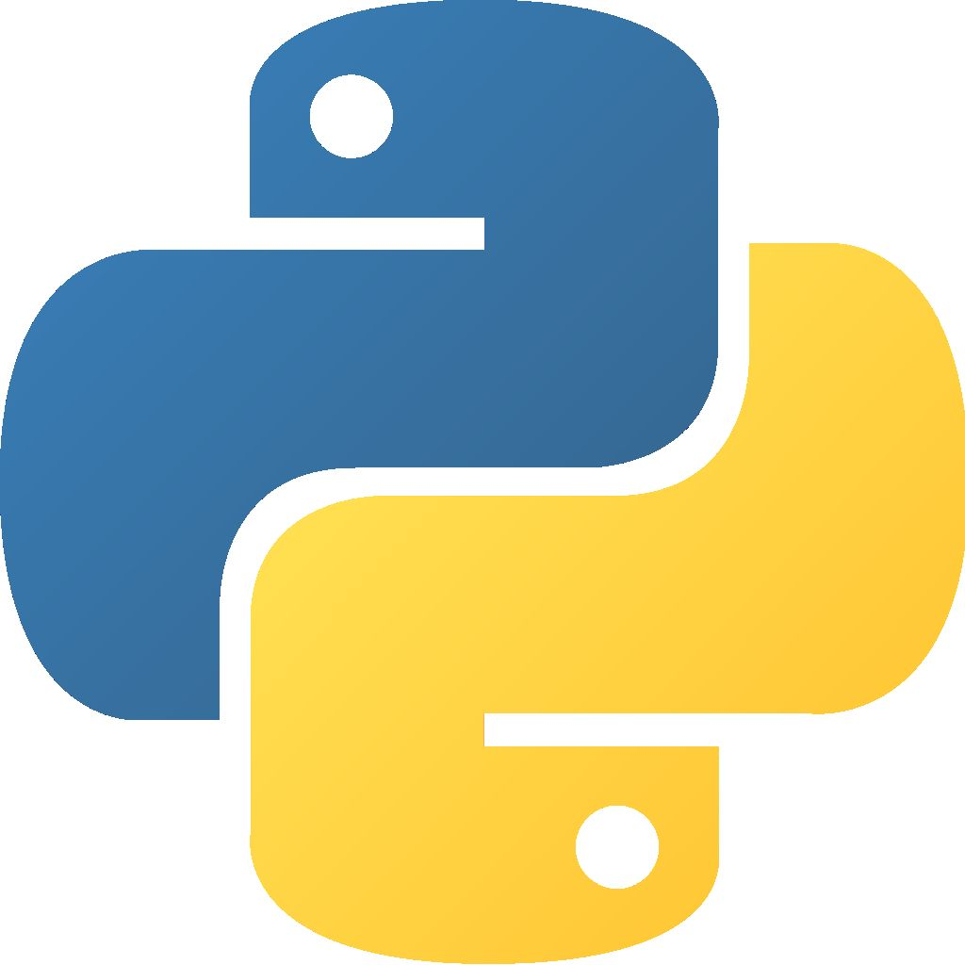
Symbol of Python

Slide 11
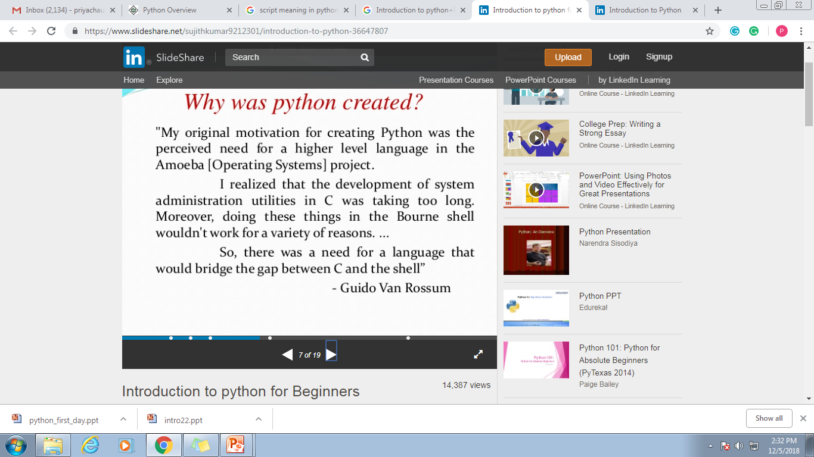
Why was Python created??

Slide 12
Releases
Created in 1989
Python 1.0 released in 1994
Python 2.0 released in 2000
Python 3.0 released in 2008
Python 2.7.9 is the recommended version
3.7.2… still in progression

Slide 13
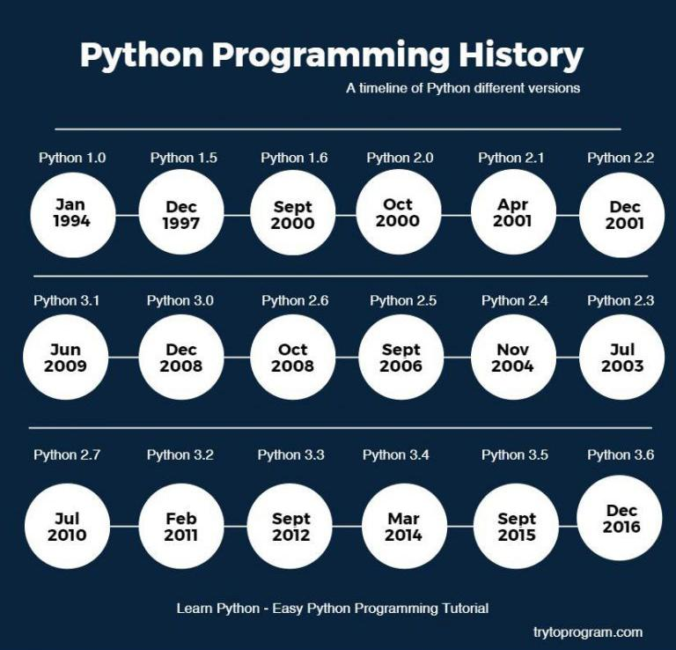

Slide 14
Features of Python
Easy-to-learn
Simple
Easy-to-maintain
A broad standard library
Interactive Mode
Portable
Extendable
Databases

Slide 15
Features of Python(Cont..)
GUI Programming
Open Source
High level language
Dynamically typed
Platform Independent
Procedure and Object-oriented

Slide 16
Applications
Web Development
Testing
Data Analysis
Big Data
Computer Graphics
Web Scrapping
Machine Learning
Internet of things

Slide 17
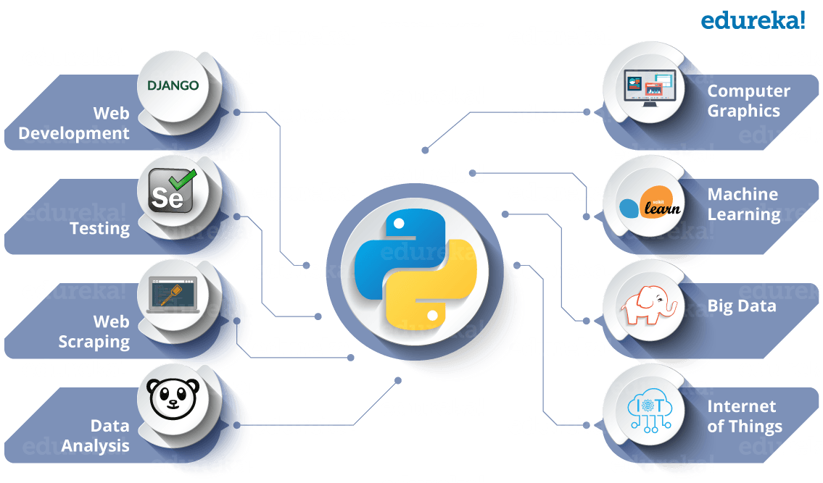

Slide 18
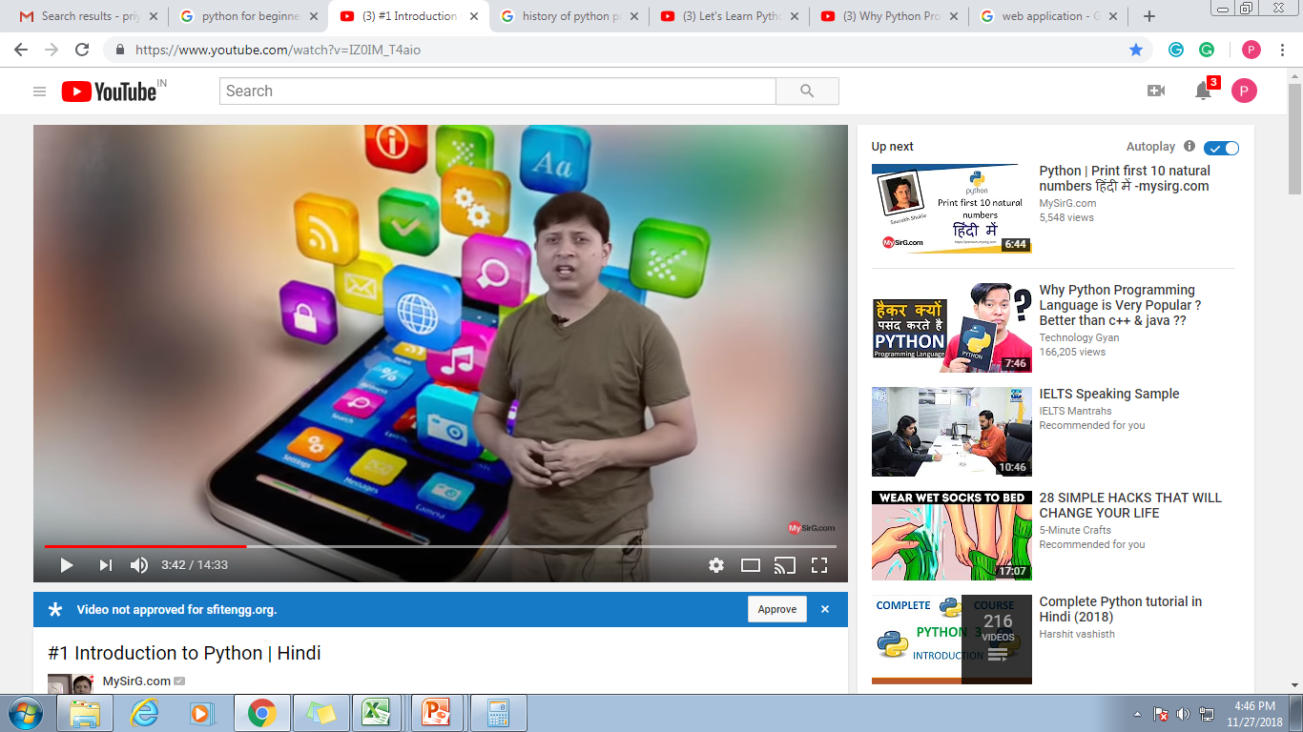
Web application

Slide 19
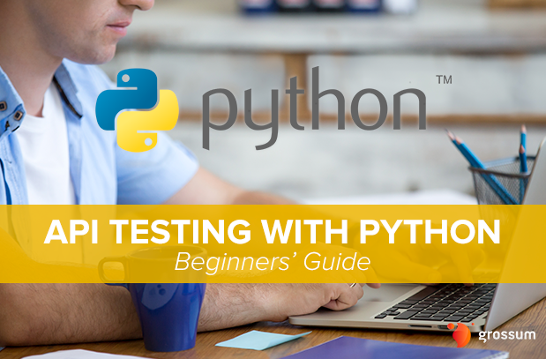
Testing

Slide 20
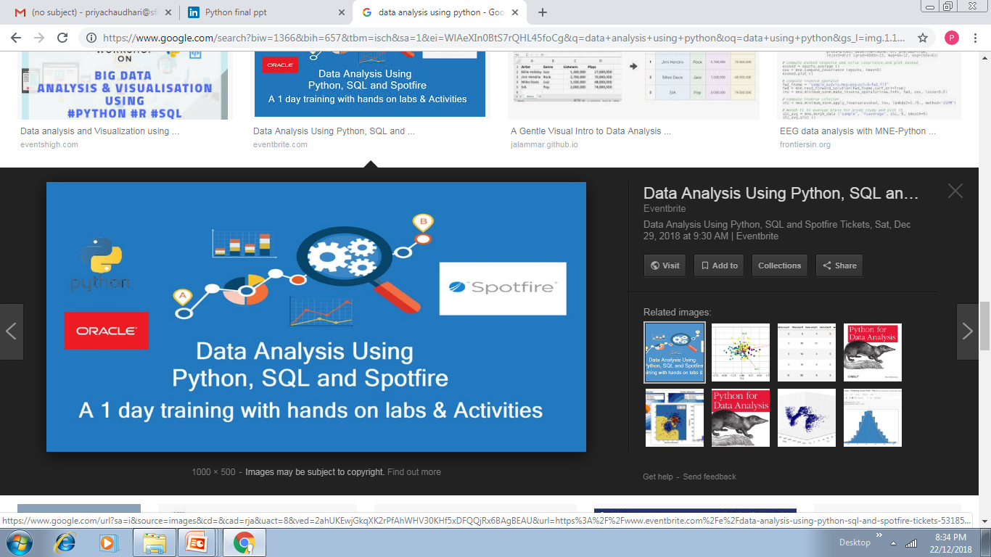
Data Analysis

Slide 21

Big Data

Slide 22
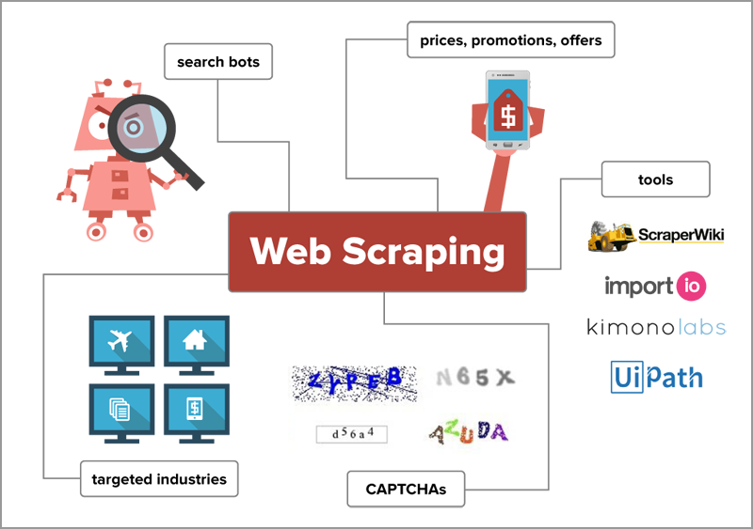
Web Scrapping

Slide 23

Computer Graphics

Slide 24

Mobile Application

Slide 25
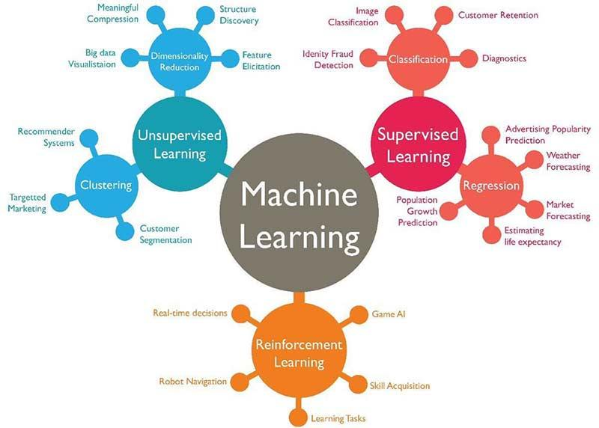
Machine Learning

Slide 26

Internet of Things

Slide 27
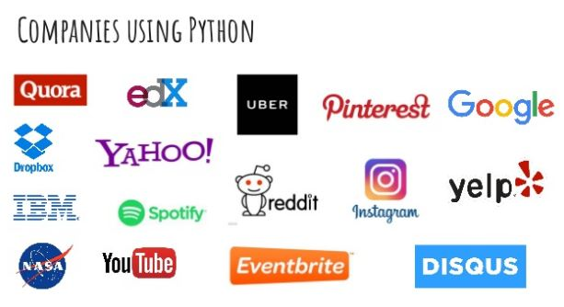
Companies using Python

Slide 28
Introduction To Python
 | C | Java | Python
Developed By Whom and When ?? | Dennis M. Ritchie In 1972 | James Gosling, June 1991. | Guido van Rossum during 1985- 1990
Open Source | No | No | Yes . GNU General Public License (GPL).
Type | Structured | Object-Oriented | Object-oriented
Complied/Interpreted | Compiled | Interpreted | Interpreted
Use For | Application, system, general purpose, low-level operations | Application, business, client-side, general, mobile development, server-side, web | Application, general, web, scripting, artificial intelligence, scientific computing

Slide 29
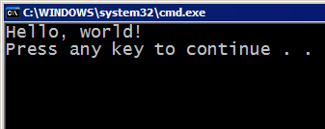
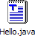
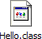


Compiling and Interpreting
Many languages require you to compile (translate) your program into a form that the machine understands.
Python is instead directly interpreted into machine instructions.
compile
execute
source code
Hello.java
byte code
Hello.class
output
interpret
source code
Hello.py
output

Slide 30
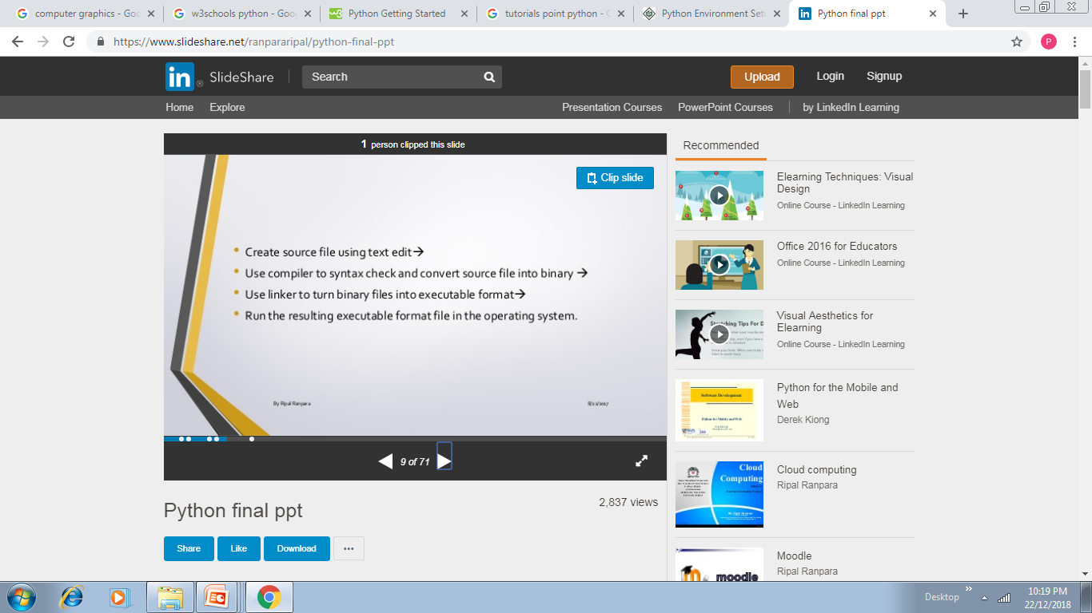
Compiler

Slide 31
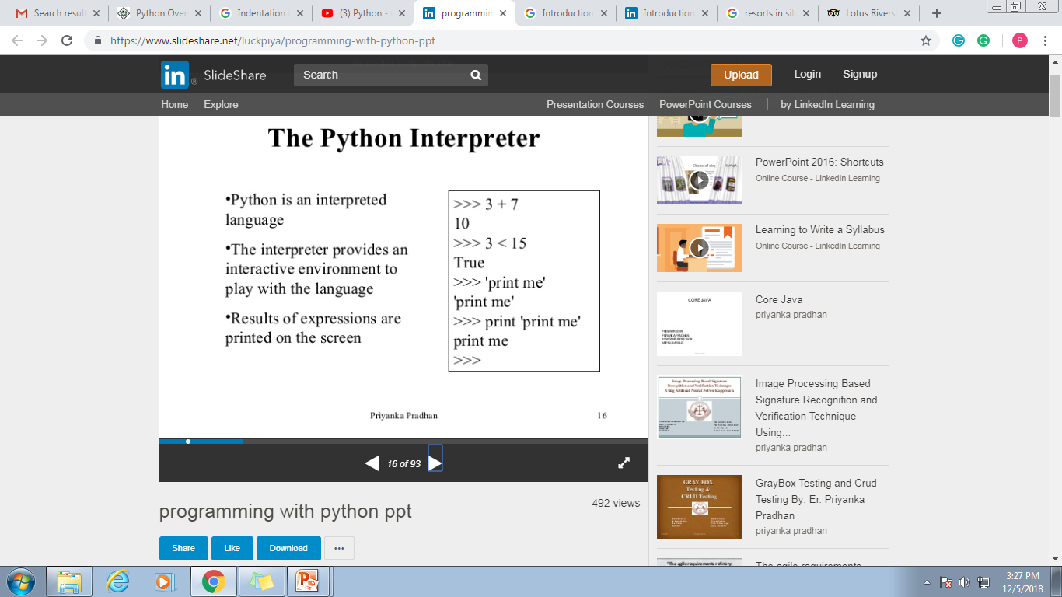

Slide 32
Installing
Python is pre-installed on most Unix systems, including Linux and MAC OS X
The pre-installed version may not be the most recent one (2.6.2 and 3.1.1 as of Sept 09)
Download from http://python.org/download/
Python comes with a large library of standard modules
There are several options for an IDE
IDLE – works well with Windows
Emacs with python-mode or your favorite text editor
Eclipse with Pydev (http://pydev.sourceforge.net/)

Slide 33
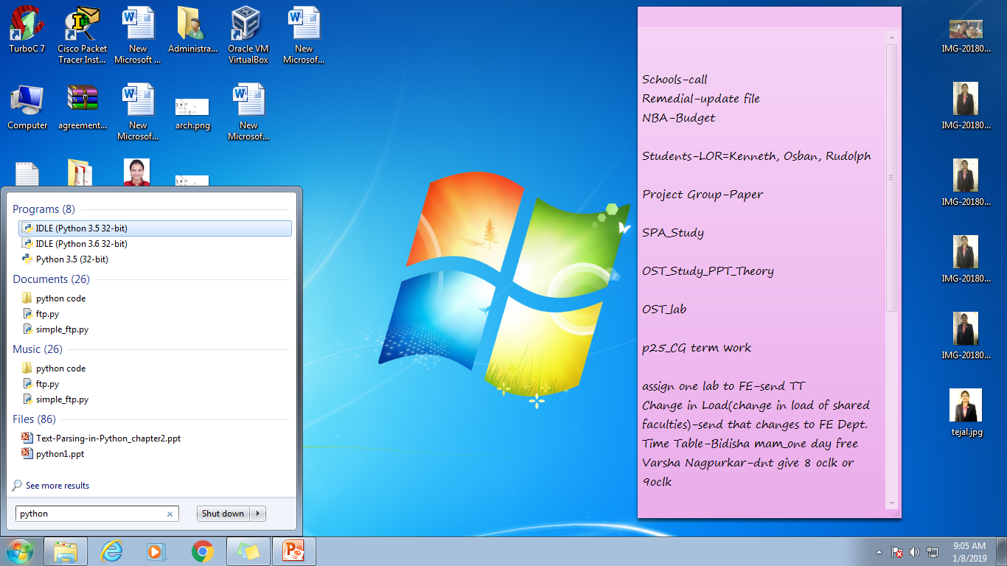
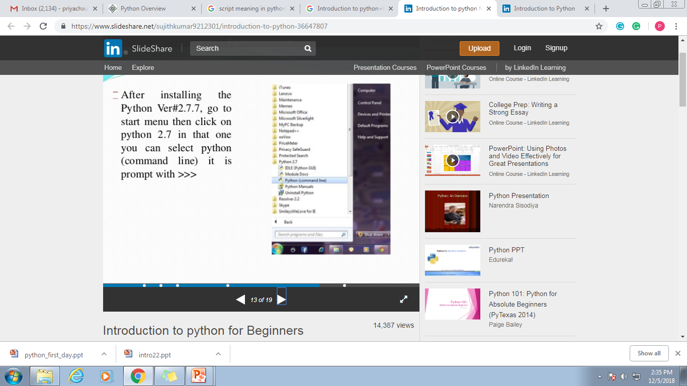

Slide 34
IDLE Development Environment
IDLE is an Integrated DeveLopment Environ-ment for Python, typically used on Windows
Multi-window text editor with syntax highlighting, auto-completion, smart indent and other.
Python shell with syntax highlighting.
Integrated debugger with stepping, persistent breakpoints, and call stack visibility.

Slide 35
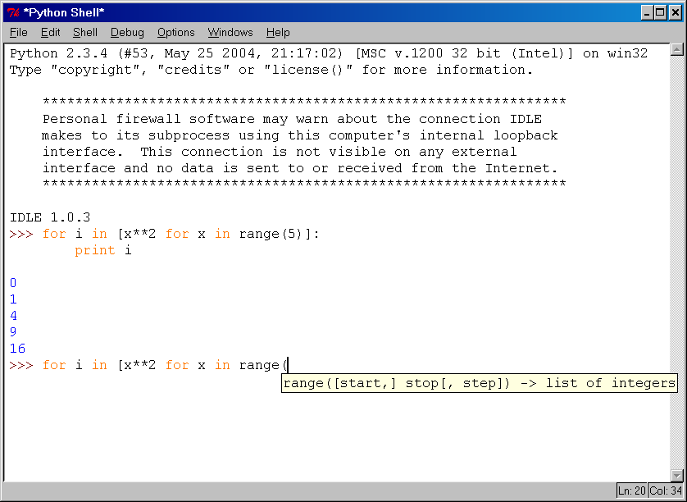
IDLE Development Environment

Slide 36
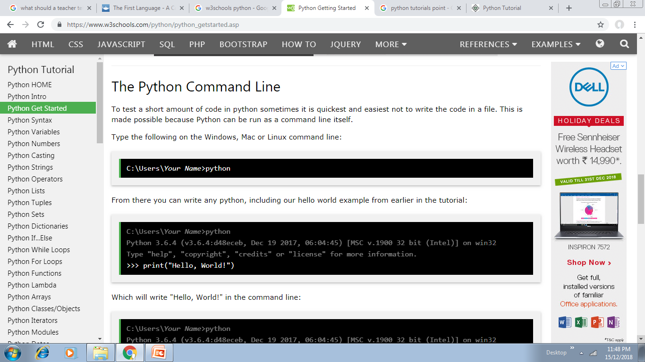
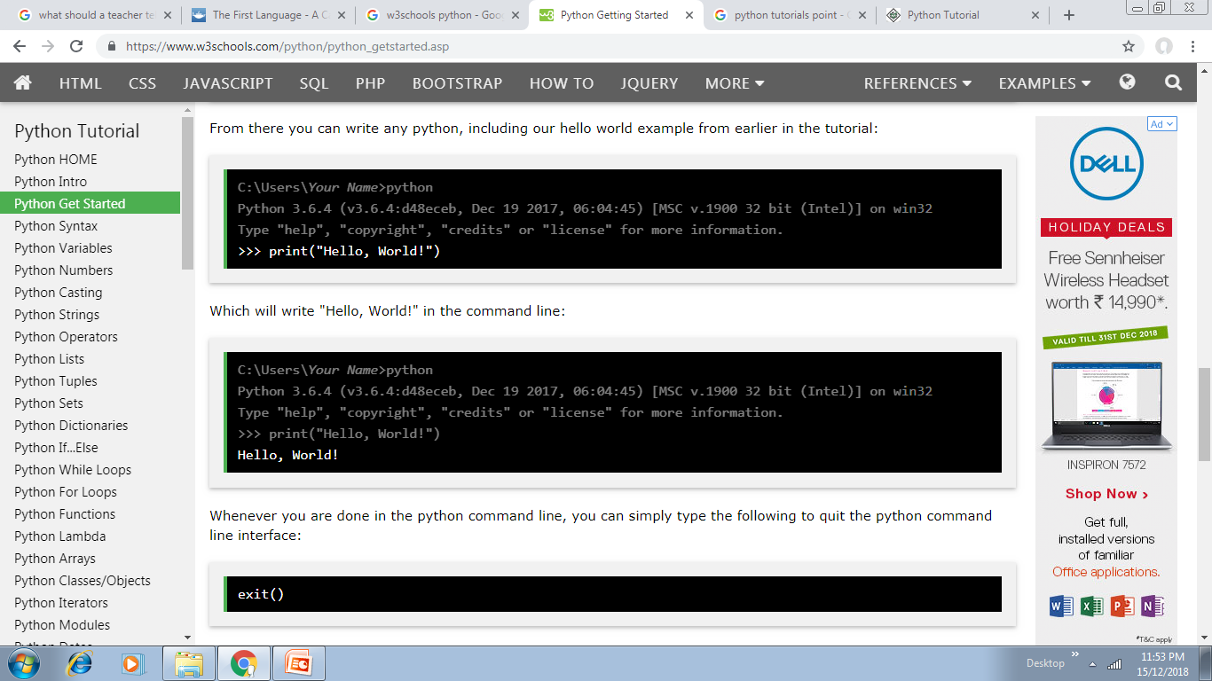

Slide 37
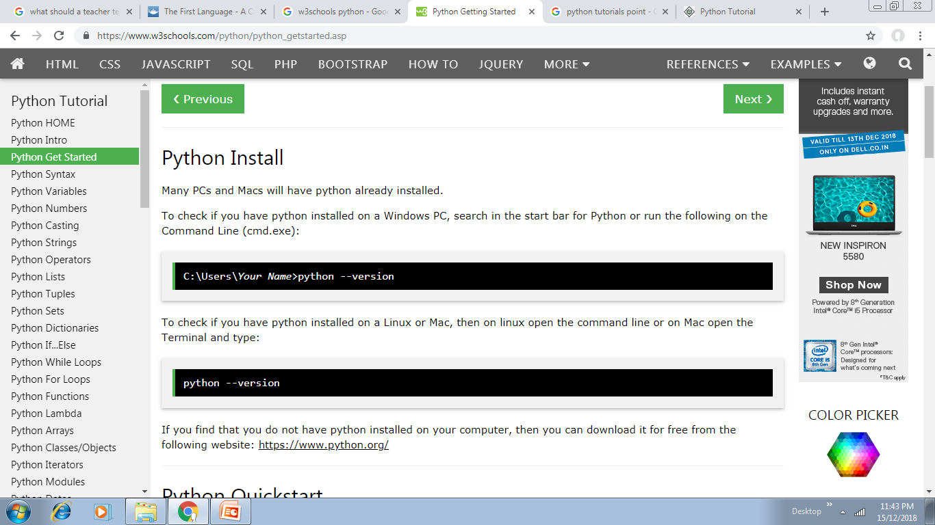
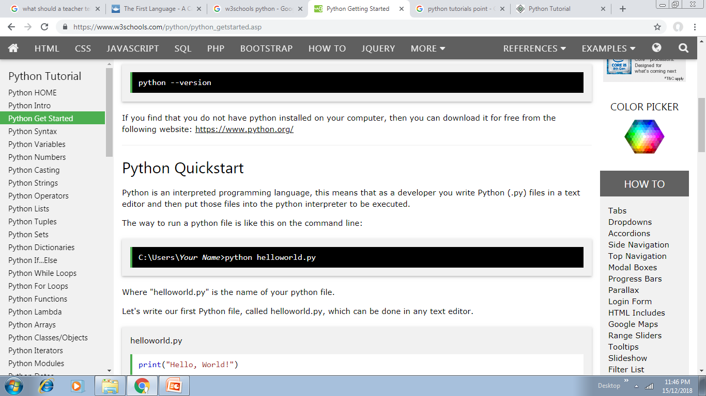
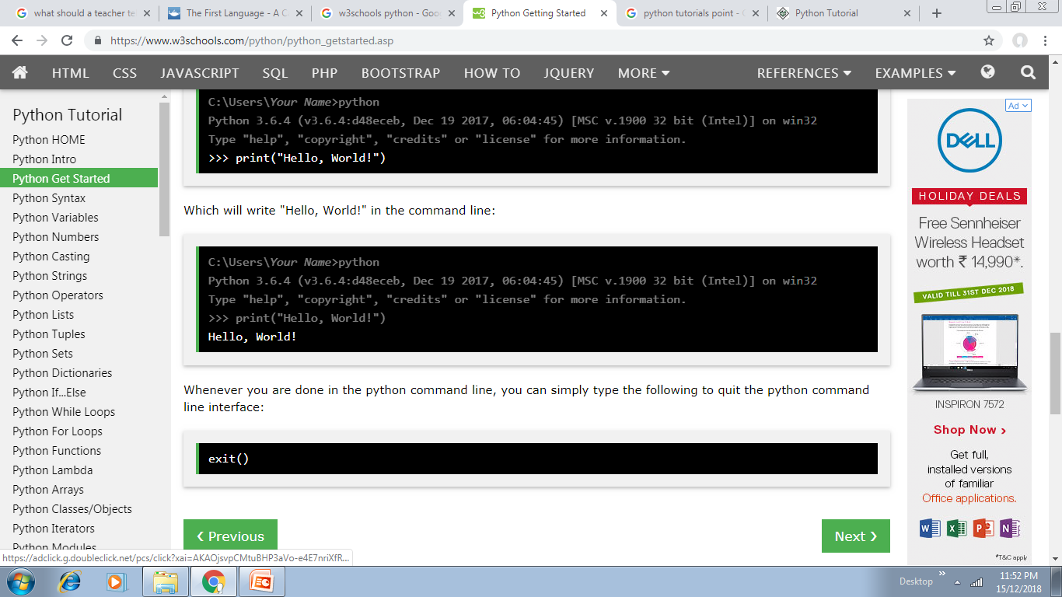

Slide 38
Running Interactively on UNIX
On Unix…
% python
>>> 3+3
6
Python prompts with ‘>>>’.
To exit Python (not Idle):
In Unix, type CONTROL-D
In Windows, type CONTROL-Z + <Enter>
Evaluate exit()

Slide 39
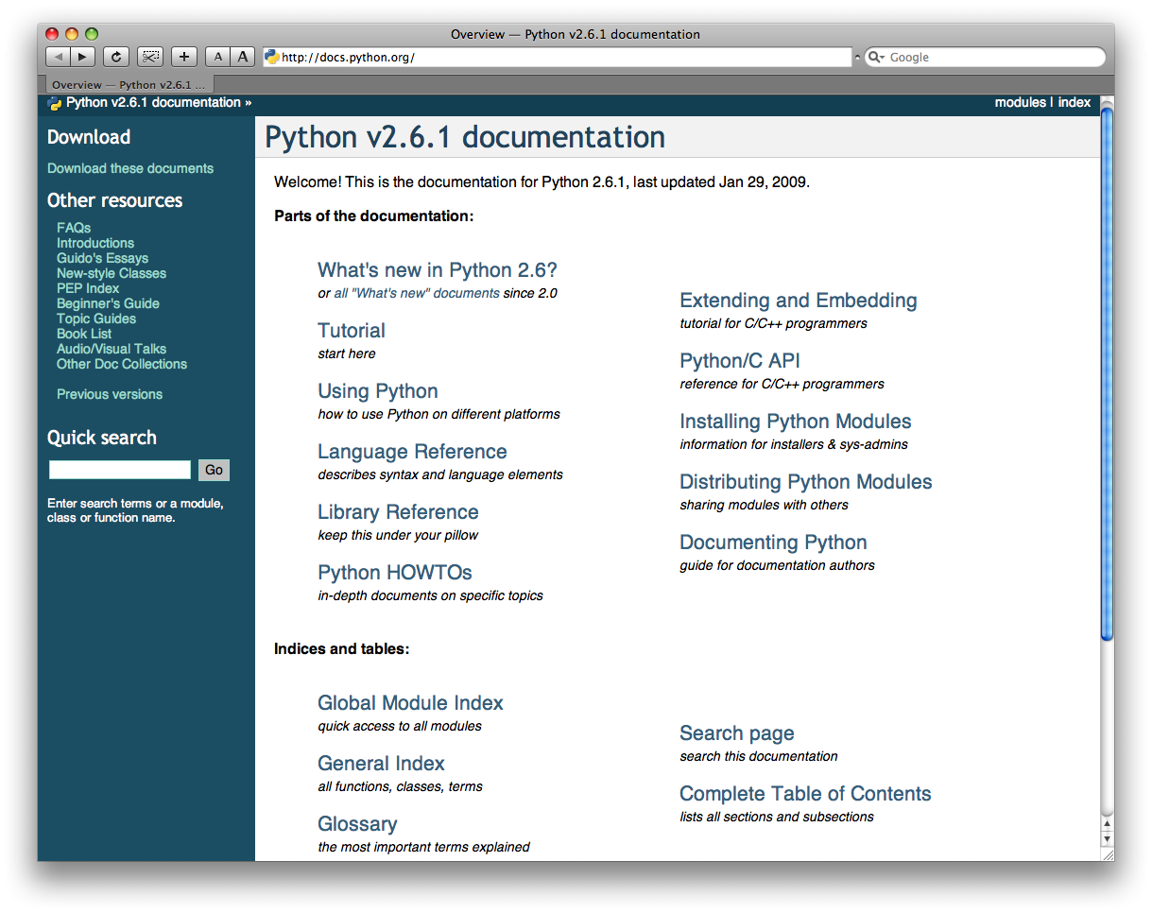
http://docs.python.org/

Slide 40
Running Programs on UNIX
Call python program via the python interpreter
% python fact.py
Make a python file directly executable by
Adding the appropriate path to your python interpreter as the first line of your file
#!/usr/bin/python
Making the file executable
% chmod a+x fact.py
Invoking file from Unix command line
% fact.py

Slide 41
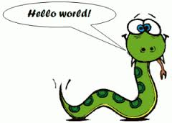
Program 1 : Hello World
Language | Program
C | #include<stdio.h> void main() { printf(“ Hello World”); }
Java | class HelloWorldApp { public static void main(String[] args) { System.out.println("Hello World!"); } }
Python | print “Hello World”
Notes:
Observe the program ..no semicolon ,no braces…besides no of lines

Slide 42
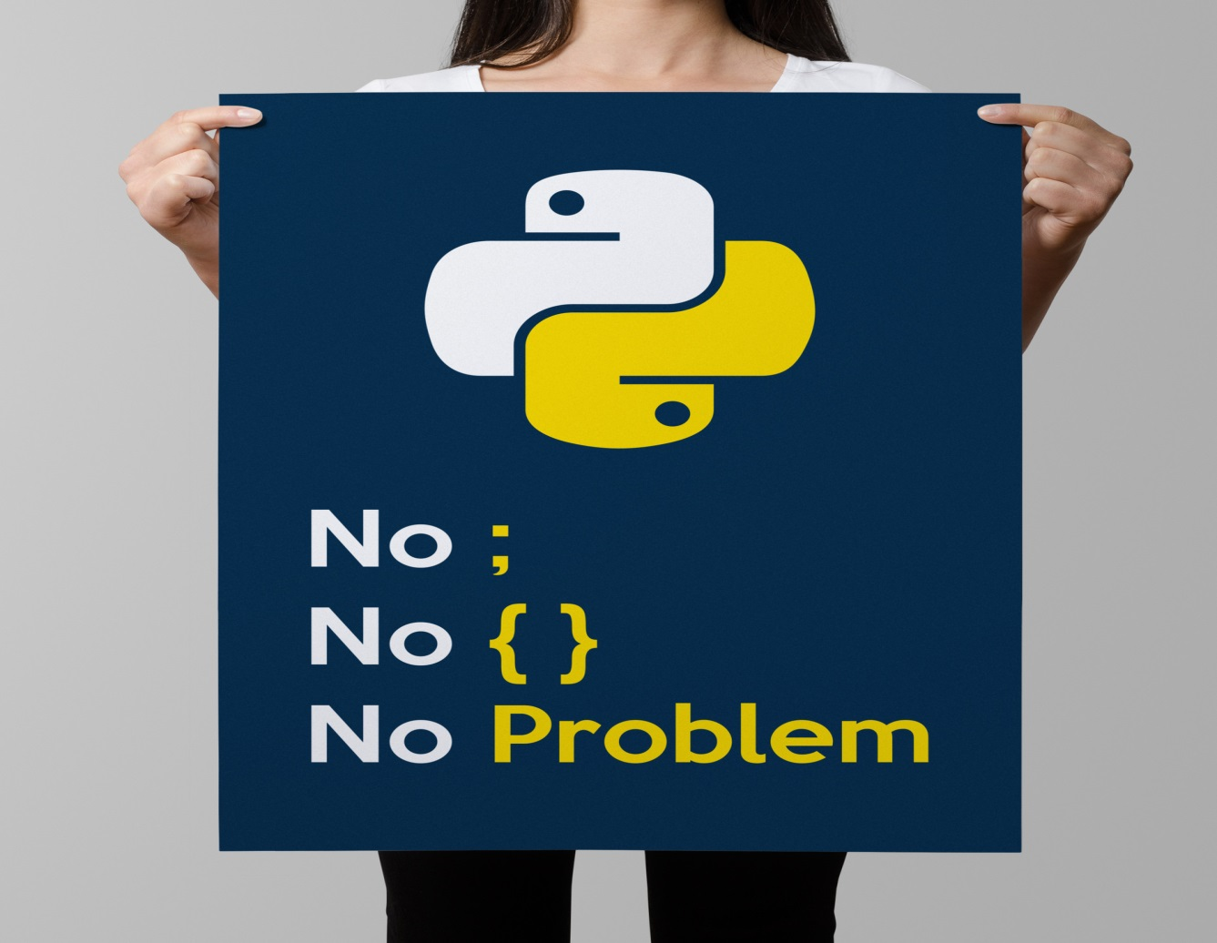
First Lesson In Python

Slide 43
Run /Execute First Python Program
Steps :
Open Python Shell
Type your code
Enter
OR
Open Python GUI
Click File New –Type program –save with extension .py
Run Module

Slide 44
Program 2a: Addition of two numbers
C | Java | Python
#include <stdio.h> void main() { int a,b,sum; a=10; b=10; sum=0; sum=a+b; printf( “The sum is %d” ,sum); } | class AddNumbers { public static void main (String args[]) { int x, y, z; x=10; y=10; z = x + y; System.out.println("Sum of entered integers = "+z); } } | a=10 b=10 c=a+b print ( “Sum is” ,c)

Slide 45
Lesson 3: Whitespace & comments

Slide 46
Whitespace(Indentation)
Whitespace is very important in Python .It is used to structure code.
Python uses indentation instead of braces to determine the scope of expressions
All lines must be indented the same amount to be part of the scope (or indented more if part of an inner scope)
This forces the programmer to use proper indentation since the indenting is part of the program!
Notes:
No semicolon—no braces ???

Slide 47
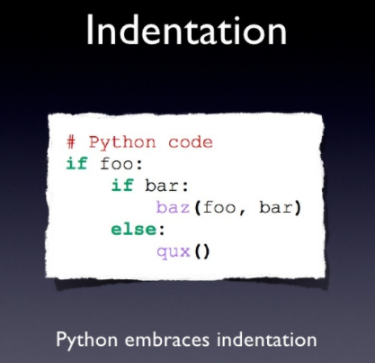

Slide 48
Indentation
if 5 > 2:
print("Five is greater than two!")
if 5 > 2:
print("Five is greater than two!")

Slide 49
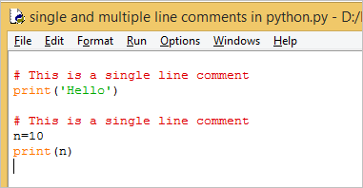
Comments
Single Line Comment use #.
Entire line till the end should be treated as comment

Slide 50
Comments
Multi Line Comment use “”” “”” OR ‘’’ ‘’’
Enclose a block of line as comments.
"""This is also a perfect example of multi-line comments"""

Slide 51
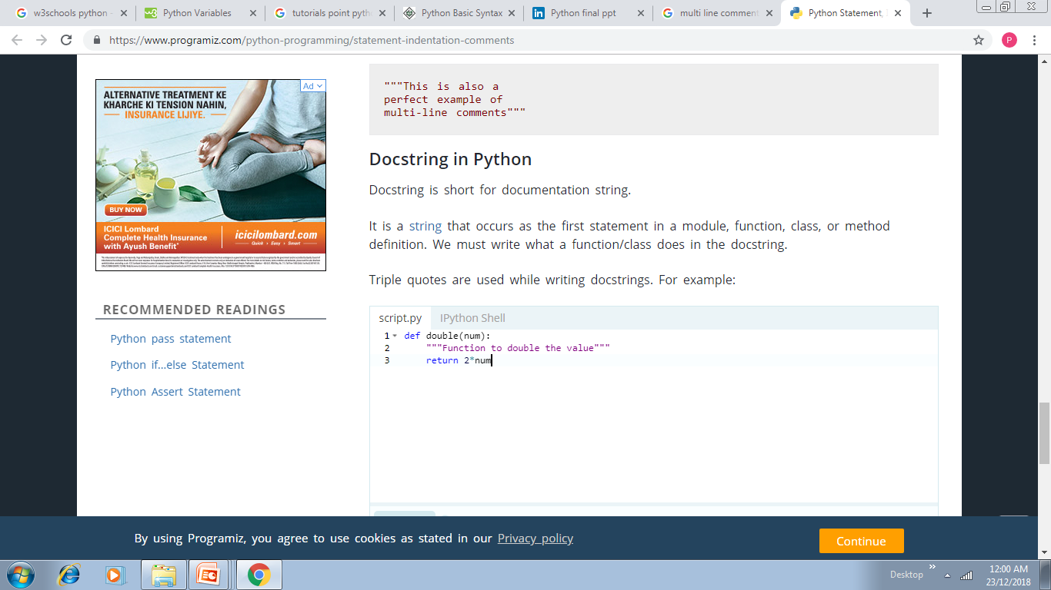
Comments
Docstring is short for documentation string.
It is a string that occurs as the first statement
in a module, function, class, or method definition.
We must write what a function/class does in the docstring.
Triple quotes are used while writing docstrings. For example:

Slide 52
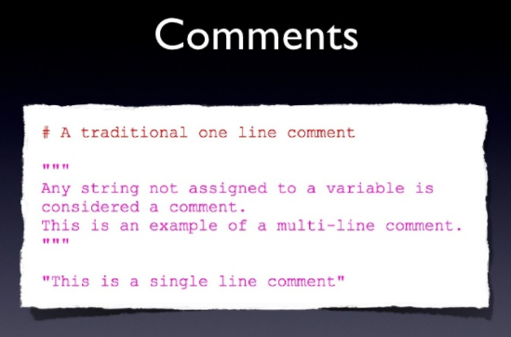

Slide 53
Lesson 2: No Explicit Variables Declaration
Variables are nothing but reserved memory locations to store values. This means that when you create a variable you reserve some space in memory.
Based on the data type of a variable, the interpreter allocates memory and decides what can be stored in the reserved memory. Therefore, by assigning different data types to variables, you can store integers, decimals or characters in these variables.
Python variables do not need explicit declaration to reserve memory space. The declaration happens automatically when you assign a value to a variable. The equal sign (=) is used to assign values to variables.
Notes:
int a ; float b –variable naming conventions

Slide 54
Lesson 2: No Explicit Variables Declaration
Examples :
my_int=7
my_float=1.23
my_bool=True

Slide 55
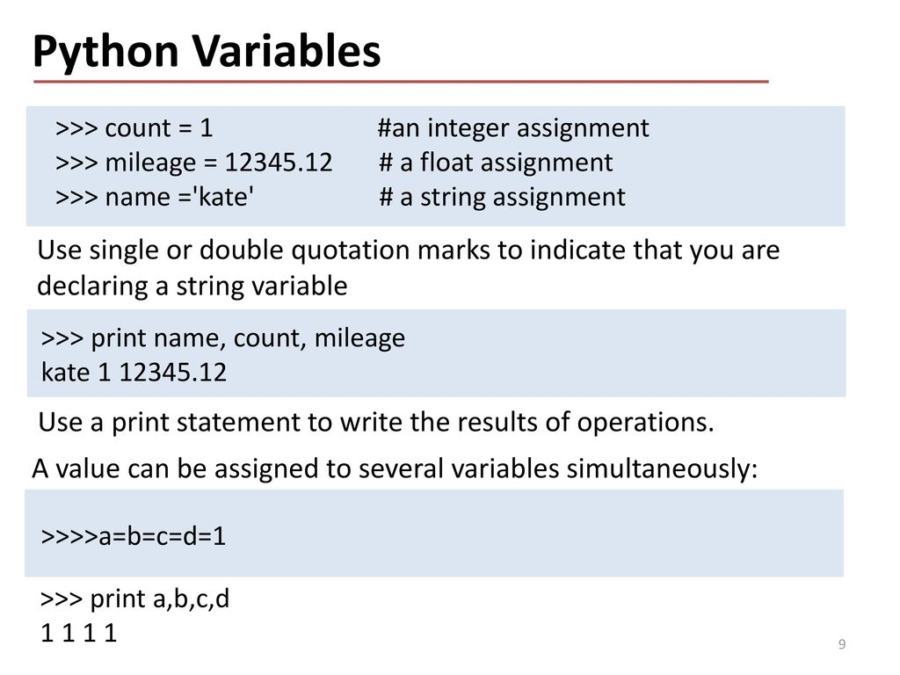

Slide 56
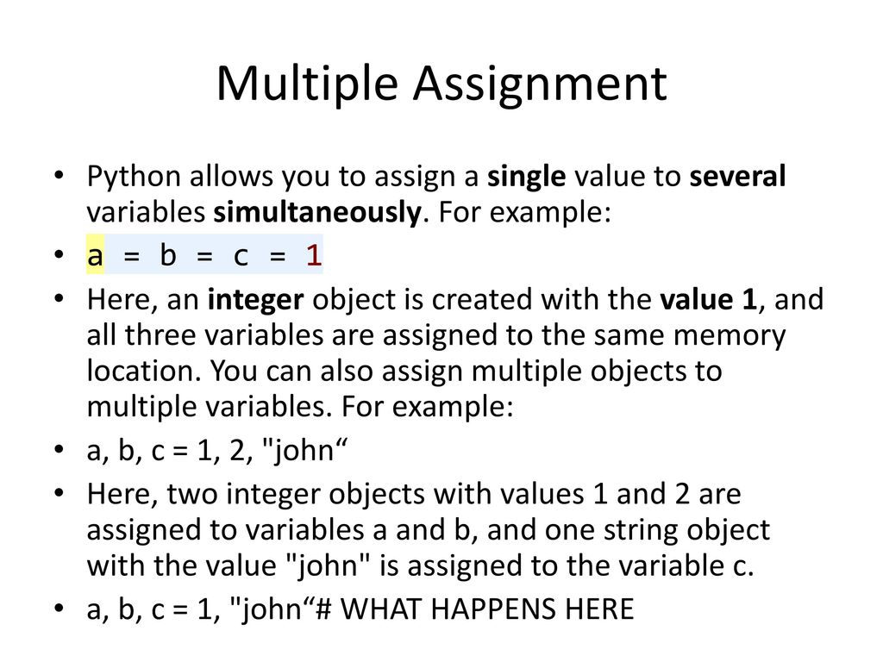

Slide 57
Operators in Python
Python language supports the following types of operators.
Arithmetic Operators
Comparison (Relational) Operators
Assignment Operators
Logical Operators
Bitwise Operators
Membership Operators
Identity Operators

Slide 58
Operators in Python (Arithmetic Operator)
Arithmetic operators are used to perform mathematical operations like addition, subtraction, multiplication etc.

Slide 59
Operators in Python (Arithmetic Operator-Overview)
Operator | Meaning | Example
+ | Add two operands or unary plus | x + y +2
- | Subtract right operand from the left or unary minus | x - y -2
* | Multiply two operands | x * y
/ | Divide left operand by the right one (always results into float) | x / y
% | Modulus - remainder of the division of left operand by the right | x % y (remainder of x/y)
// | Floor division - division that results into whole number adjusted to the left in the number line | x // y
** | Exponent - left operand raised to the power of right | x**y (x to the power y)

Slide 60
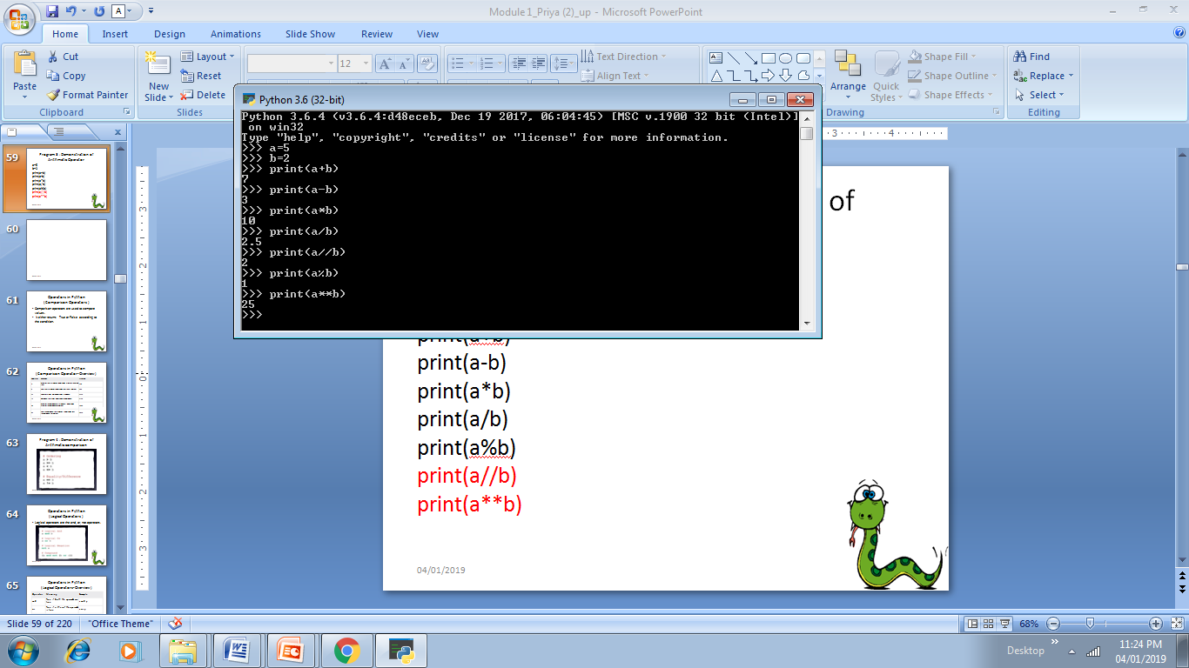

Slide 61
Program 3 : Demonstration of Arithmetic Operator
a=5
b=2
print(a+b)
print(a-b)
print(a*b)
print(a/b)
print(a%b)
print(a//b)
print(a**b)

Slide 62
Operators in Python (Comparison Operators )
Comparison operators are used to compare values.
It either returns True or False according to the condition.

Slide 63
Comparison Operator
Operator | Meaning | Example
> | Greater that - True if left operand is greater than the right | x > y
< | Less that - True if left operand is less than the right | x < y
== | Equal to - True if both operands are equal | x == y
!= | Not equal to - True if operands are not equal | x != y
>= | Greater than or equal to - True if left operand is greater than or equal to the right | x >= y
<= | Less than or equal to - True if left operand is less than or equal to the right | x <= y

Slide 64
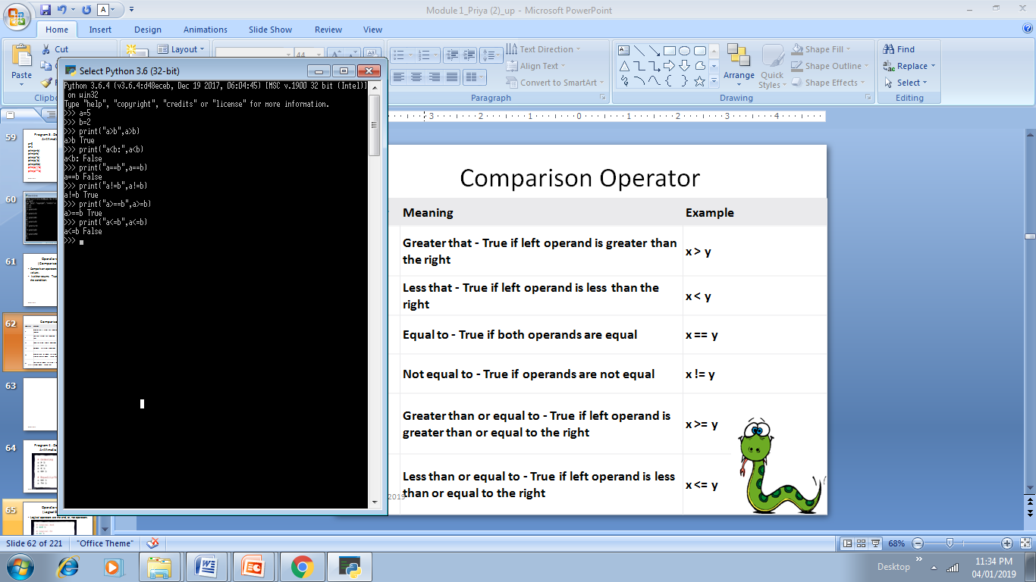

Slide 65
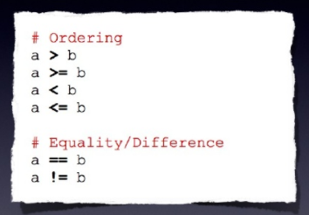
Program 4 : Demonstration of Arithmetic comparison

Slide 66
Operators in Python (Logical Operators-Overview)
Operator | Meaning | Example
and | True if both the operands are true | x and y
or | True if either of the operands is true | x or y
not | True if operand is false (complements the operand) | not x

Slide 67
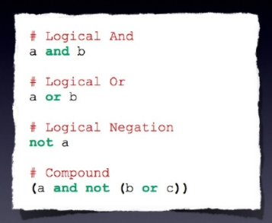
Operators in Python (Logical Operators )
Logical operators are the and, or, not operators.

Slide 68
Operators in Python (Bitwise Operators )
Bitwise operators act on operands as if they were string of binary digits. It operates bit by bit, hence the name.

Slide 69
Operators in Python ( Bitwise Operator-Overview)
Operator | Meaning | Example
& | Bitwise AND | x& y = 0 (0000 0000)
| | Bitwise OR | x | y = 14 (0000 1110)
~ | Bitwise NOT | ~x = -11 (1111 0101)
^ | Bitwise XOR | x ^ y = 14 (0000 1110)
>> | Bitwise right shift | x>> 2 = 2 (0000 0010)
<< | Bitwise left shift | x<< 2 = 42 (0010 1000)

Slide 70
if a = 60; and b = 13;
a = 0011 1100
b = 0000 1101
a&b = 0000 1100
a|b = 0011 1101
a^b = 0011 0001
~a = 1100 0011

Slide 71
Operator | Description | Example
& Binary AND | Operator copies a bit to the result if it exists in both operands | (a & b) (means 0000 1100)
| Binary OR | It copies a bit if it exists in either operand. | (a | b) = 61 (means 0011 1101)
^ Binary XOR | It copies the bit if it is set in one operand but not both. | (a ^ b) = 49 (means 0011 0001)
~ Binary Ones Complement | It is unary and has the effect of 'flipping' bits. | (~a ) = -61 (means 1100 0011 in 2's complement form due to a signed binary number.
<< Binary Left Shift | The left operands value is moved left by the number of bits specified by the right operand. | a << = 240 (means 1111 0000)
>> Binary Right Shift | The left operands value is moved right by the number of bits specified by the right operand. | a >> = 15 (means 0000 1111)

Slide 72
Operators in Python ( Assignment Operators )
Assignment operators are used in Python to assign values to variables.
a = 5 is a simple assignment operator that assigns the value 5 on the right to the variable a on the left.
There are various compound operators in Python like a += 5 that adds to the variable and later assigns the same. It is equivalent
to a = a + 5.

Slide 73
Program 4 : Demonstration of Assignment Operator
Operator | Example | Equivatent to
= | x = 5 | x = 5
+= | x += 5 | x = x + 5
-= | x -= 5 | x = x - 5
*= | x *= 5 | x = x * 5
/= | x /= 5 | x = x / 5
%= | x %= 5 | x = x % 5
//= | x //= 5 | x = x // 5
**= | x **= 5 | x = x ** 5
&= | x &= 5 | x = x & 5
|= | x |= 5 | x = x | 5
^= | x ^= 5 | x = x ^ 5
>>= | x >>= 5 | x = x >> 5
<<= | x <<= 5 | x = x << 5

Slide 74
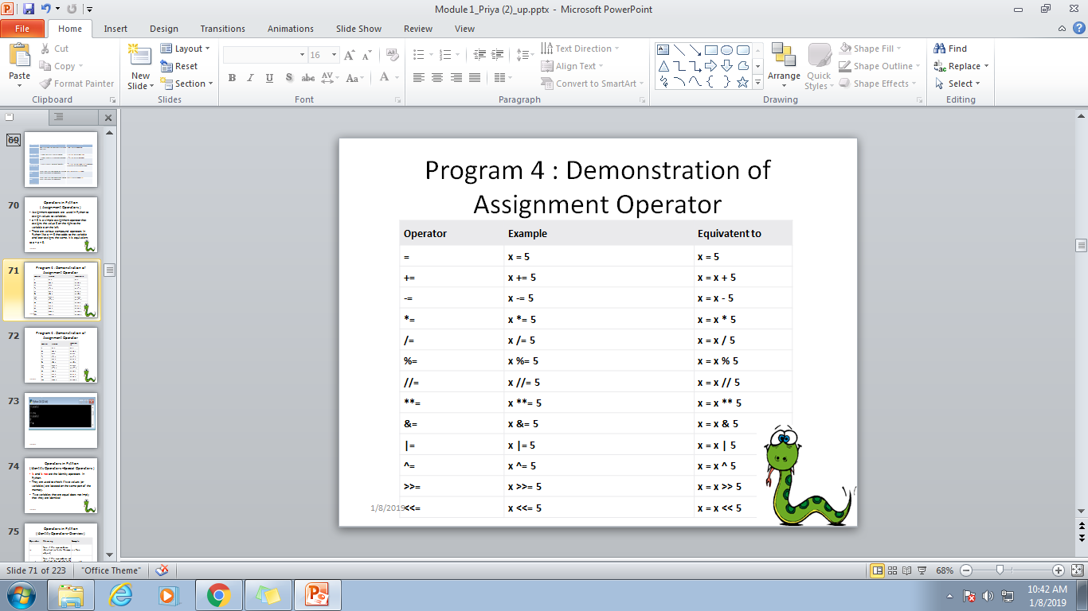

Slide 75
Program 4 : Demonstration of Assignment Operator

Slide 76
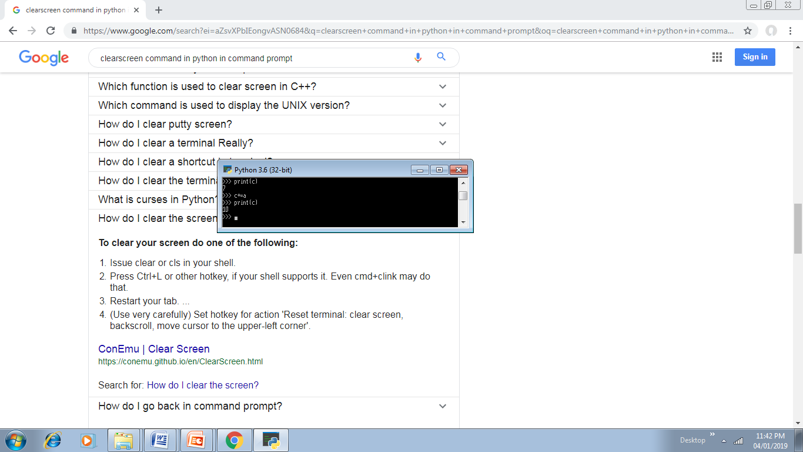

Slide 77
Operators in Python (Identity Operators –Special Operators )
is and is not are the identity operators in Python.
They are used to check if two values (or variables) are located on the same part of the memory.
Two variables that are equal does not imply that they are identical

Slide 78
Operators in Python (Identity Operators-Overview)
Operator | Meaning | Example
is | True if the operands are identical (refer to the same object) | x is True
is not | True if the operands are not identical (do not refer to the same object) | x is not True

Slide 79
Program 5 : Demonstration of Identity Operators
x1 = 5
y1 = 5
x2 = 'Hello‘
y2 = 'Hello‘
x3 = [1,2,3]
y3 = [1,2,3]
print(x1 is not y1)
print(x2 is y2)
print(x3 is y3)
Notes:
But x3 and y3 are list. They are equal but not identical. Since list are mutable (can be changed), interpreter locates them separately in memory although they are equal.

Slide 80
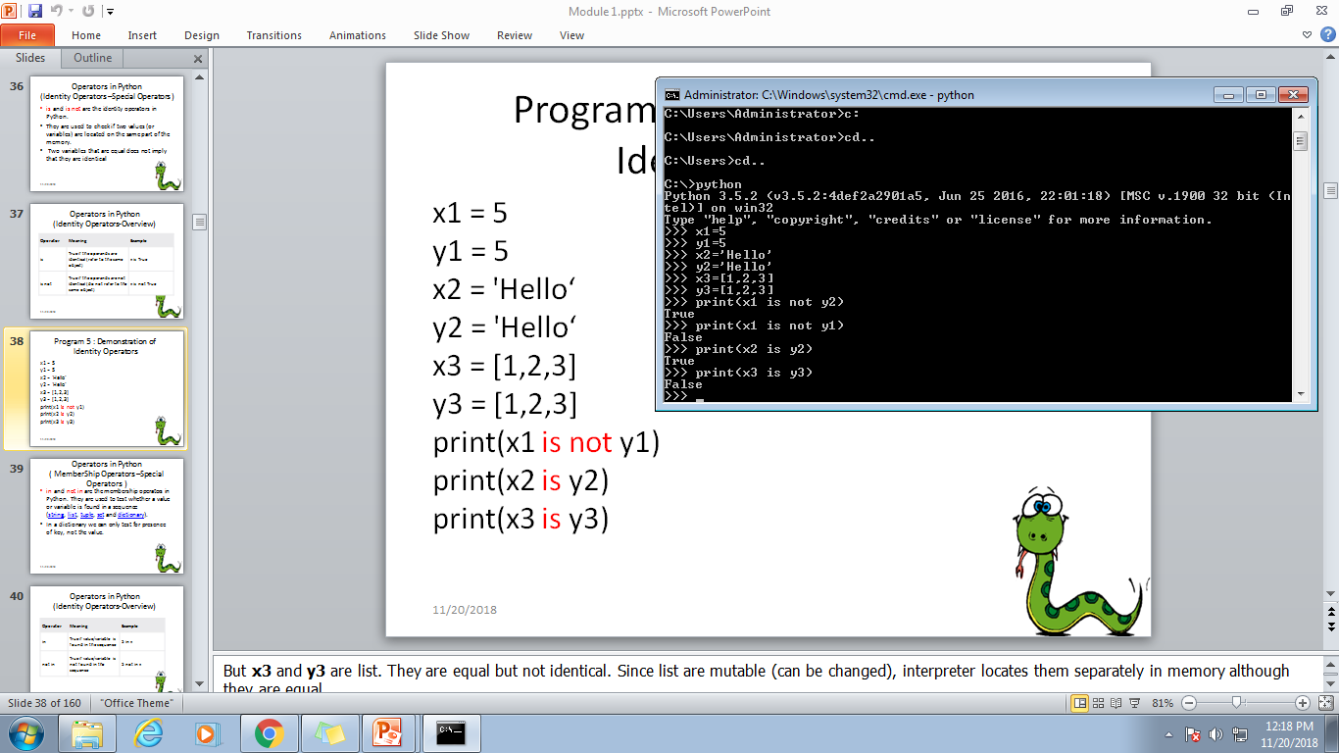

Slide 81
Operators in Python ( MemberShip Operators –Special Operators )
in and not in are the membership operators in Python. They are used to test whether a value or variable is found in a sequence (string, list, tuple, set and dictionary).
In a dictionary we can only test for presence of key, not the value.

Slide 82
Operators in Python (Identity Operators-Overview)
Operator | Meaning | Example
in | True if value/variable is found in the sequence | 5 in x
not in | True if value/variable is not found in the sequence | 5 not in x

Slide 83
Program 5 : Demonstration of Membership Operators
x = 'Hello world‘
print('H' in x)
print('Hello' not in x)
print(‘hello’ in x)

Slide 84
Lesson 4: New Operators and Case Sensitive
Python has two new operators
Identity
Membership
Python is case sensitive

Slide 85
Operator Precedence
Operator | Description
** | Exponentiation (raise to the power)
~ + - | Complement, unary plus and minus (method names for the last two are +@ and -@)
* / % // | Multiply, divide, modulo and floor division
+ - | Addition and subtraction
>> << | Right and left bitwise shift
& | Bitwise 'AND'
^ | | Bitwise exclusive `OR' and regular `OR'
<= < > >= | Comparison operators
<> == != | Equality operators
= %= /= //= -= += *= **= | Assignment operators
is is not | Identity operators
in not in | Membership operators
not or and | Logical operators

Slide 86
Input and Output Function in Python
Output Function
print()
Input Function
input()

Slide 87
Program 2b: Addition of two numbers
C | Java | Python
#include <stdio.h> void main() { int a,b,sum; sum=0; printf( Enter number a%d”); scanf(“%d” ,&a); printf( Enter number b%d”); scanf(“%d” ,&b); sum=a+b; printf( “The sum is %d” ,sum); } | import java.util.Scanner; class AddNumbers { public static void main(String args[]) { int x, y, z; System.out.println("Enter two integers to calculate their sum "); Scanner in = new Scanner(System.in); x = in.nextInt(); y = in.nextInt(); z = x + y; System.out.println("Sum of entered integers = "+z); } } | a=input( “Enter First no”) b=input(“Enter second number”) sum=a+b print(“Sum is”,sum)

Slide 88
Lesson 5: By default datatype of data taken by using Input Function is string
As by default datatype of data taken by using Input Function is string.
Change the datatype to int to perform mathematical operations.
a=int(input("Enter First no"))
b=int(input("Enter second number"))
sum=a+b
print("Sum is",sum)

Slide 89
Recap 1
Recall all lessons we have learn till now
Lesson 1 : No Semicolon ,No { }
Lesson 2 : No need of Explicit Variable Declaration
Lesson 3 : Whitespace act as delimiters and single line comments # and multi line comment with ‘’’ ‘’’
Lesson 4 :New operators : Identity and Membership
Python is case sensitive language
Lesson 5 : print() and input() are I/O functions.

Slide 90
Exercise 1
WAP to display your name and college name
Modify first program add your designation with your name ,but it should be displayed on new line.
WAP to calculate area of circle. Define pi=3.14 and radius 2
Modify the program number 2 in such a way that area will be rounded number.
Modify the program number 4 – take radius as input from user.

Slide 91
Solution of Exercise 1
Program to display your name and college name
print( “Smita Dange”)
print( “Fr.C.R.I.T ,Vashi”)

Slide 92
Solution of Exercise 2
Modify first program add your designation with your name ,but it should be displayed on new line.
print( “Smita Dange. \n Asst. Professor”)
print( “Fr.C.R.I.T ,Vashi”)

Slide 93
Solution of Exercise 3
Program to calculate area of circle. Define pi=3.14 and radius.
pi=3.14 # pi ,r =3.14 ,2 Multiple Assignments
r=2
area= 3.14 *r*r # 3.14*r**2
print(“Area is “,area)

Slide 94
Solution of Exercise 4
Modify the program number 2 in such a way that area will be rounded number.
pi=3.14
r=2
area= 3.14 *r*r # 3.14*r**2
print(“Area is “,int(area))
print(type(area))

Slide 95
Solution of Exercise 5
Modify the program number 4 – take radius as input from user.
pi=3.14
r=int(input(“Enter the radius”))
area= 3.14 *r*r # 3.14*r**2
print(“Area is “,int(area))

Slide 96
New Things learn from Exercise
\n –for new line
Multiple Assignment
Conversion of datatype
x=int(x)
y=float(y)
Checking datatype of variable
type()
Operator Evaluation Sequence

Slide 97
Python Variables
A Python variable is a reserved memory location to store values.
Unlike other programming languages, Python has no command for declaring a variable.
A variable is created the moment you first assign a value to it.
Python uses Dynamic Typing so,
We need not to specify the data types to the variable as it will internally assign the data type to the variable according to the value assigned.
we can also reassign the different data type to the same variable, variable data type will change to new data type automatically.
We can check the current data type of the variable with type(variablename) in-built function.
Rules for variable name
Name can not start with digit
Space not allowed
Can not contain special character
Python keywords not allowed
Should be in lower case

Slide 98
Example of Python variable
demo.py
1
2
3
4
5
6
7
8
9
10
x = 10
print(x)
print(type(x))
y = 123.456
print(y)
x = "engneering and technology"
print(x)
print(type(x))
Output
10
int
123.456
engineering and technology
str

Slide 99
Python Keywords and Identifiers
Keywords are predefined, reserved words used in Python programming that have special meanings to the compiler.
We cannot use a keyword as a variable name, function name, or any other identifier. They are used to define the syntax and structure of the Python language.
All the keywords except True, False and None are in lowercase and they must be written as they are. The list of all the keywords is given below.

Slide 100
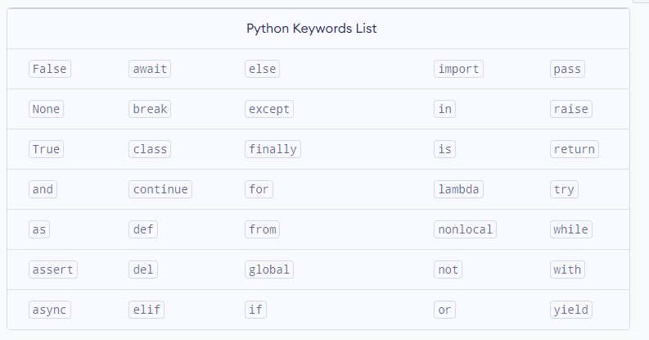

Slide 101
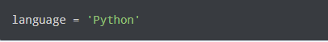
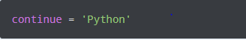
Python Identifiers
Here, language is a variable (an identifier) which holds the value 'Python'.
We cannot use keywords as variable names as they are reserved names that are built-in to Python. For example,

Slide 102
Python Numbers
Number data types store numeric values. They are immutable data types, which means that changing the value of a number data type results in a newly allocated object.
Different types of Number data types are :
Int
Float
complex

Slide 103
Int type
int (Integers) are the whole number, including negative numbers but not fractions. In Python, there is no limit to how long an integer value can be.
Example 1: Creating int and checking type
1 num = -8
2 # print the data type
3 print(type(num))
Output:
<class 'int'>

Slide 104
Float type
This is a real number with floating-point representation. It is specified by a decimal point. Some examples of numbers that are represented as floats are 0.5 and -7.823457.
They can be created directly by entering a number with a decimal point, or by using operations such as division on integers. Extra zeros present at the number’s end are ignored automatically.
Example 1: Creating float and checking type
1 num = 3/4
2 # print the data type
3 print(type(num))
Output:
<class 'float'>

Slide 105
Complex type
A complex number is a number that consists of the real and imaginary parts. For example, 2 + 3j is a complex number where 2 is the real component, and 3 multiplied by j is an imaginary part.
Example 1: Creating Complex and checking type
1 num = 6 + 9j
2 print(type(num))
Output:
<class 'complex'>

